Slide 1
Heart Disease Prediction
Team Mates:
2103A52064
2103A52014
2103A52166
2103A52146

Slide 2
The appropriate algorithms used for heart disease prediction are neural networks ,decision trees and logistic regression.

Slide 3
Building a heart disease prediction project using AI/ML involves -collecting and pre-processing data -selecting relevant features -choosing the appropriate machine learning algorithm -training and evaluating the model and -optimizing the model parameters..

Slide 4
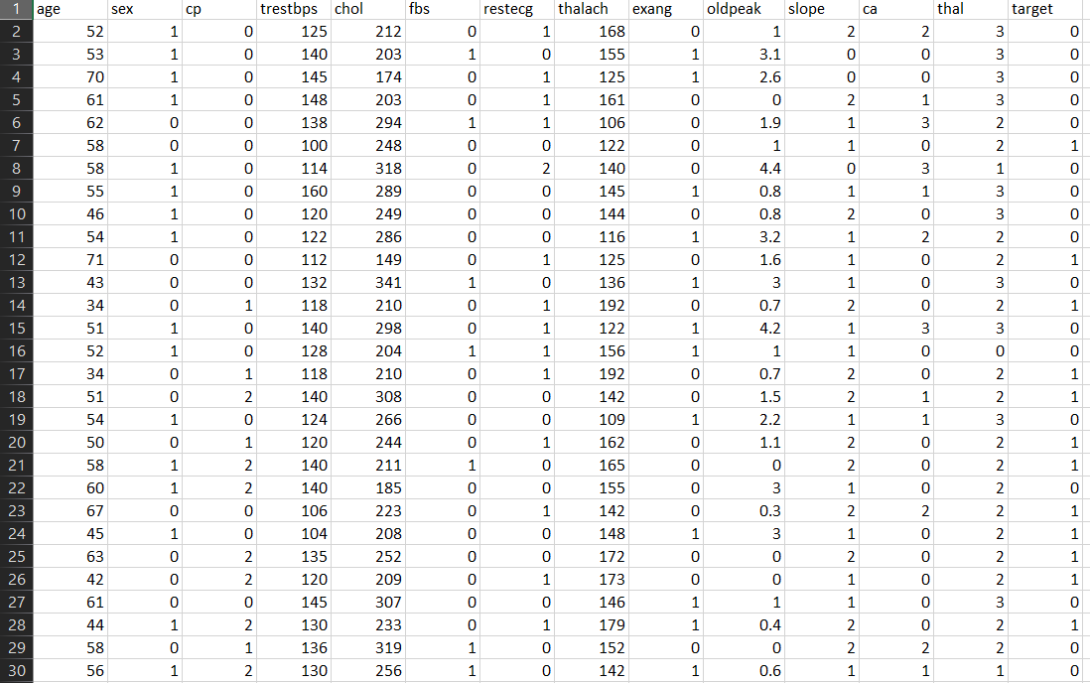
Dataset:

Slide 5
Table of Contents
01
02
03
04
05
The Disease
Diagnosis
Recommendation
You could describe the topic of the section here
You could describe the topic of the section here
You could describe the topic of the section here
Pathology
Treatment
You could describe the topic of the section here
You could describe the topic of the section here

Slide 6

A Picture is Worth a Thousand Words

